Slide 1
Examples of energy modelling tools (model generators) using linear optimisation
MARKAL
(MARKet ALlocation)
Technology explicit, dynamic partial equilibrium models of energy markets.
Differ in technical features and properties (time length, timeslices definition, etc)
MARKAL and TIMES are developed by IEA-ETSAP.
TIMES
(The Integrated MARKAL-EFOM System)
Flexible framework for the comprehensive assessment of energy challenges
Development of energy scenarios and identification of socioeconomic and technological response strategies
The mathematical formulation ensures that the flows are consistent: demand is met, inflows equal outflows and constraints are not exceeded.
MESSAGE is developed by IIASA/IAEA.
MESSAGE
(Model for Energy Supply System Alternatives and their General Environmental Impacts)
OSeMOSYS
(Open Source Energy Modelling System)
Open source long-term energy model generator based on LP principle
Flexible and organised in blocks; user has access to the code and can implement changes to fit its problem
Developed by KTH-dESA and partners

Slide 2
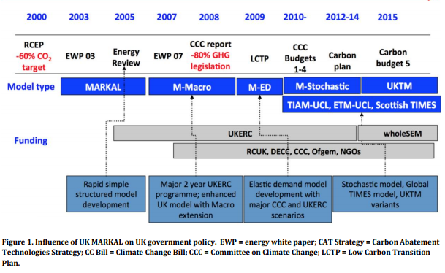
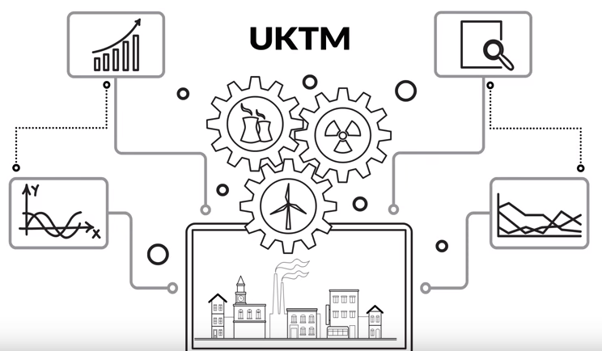
Examples of the use of model generators
MARKAL: UK MARKAL
TIMES: UKTM-UCL
TIMES is now preferred as a model generator (more flexible and internationally developed)
Opportunity to undergo a comprehensive review and revision of UK MARKAL’s design, underlying data and assumptions.
UKTM-UCL introduction video
https://youtu.be/tOV5Q0e_RW0

Slide 3
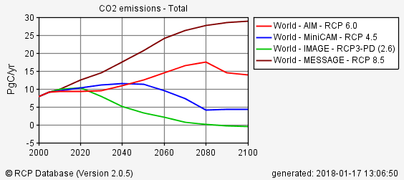
Examples of the use of model generators
MESSAGE
Among others, MESSAGE is used in the assessments and special reports of the IPCC and the Global Energy Assessment (GEA).
Used to generate one of the four Representative Concentration Pathways (RCPs). RCP8.5 is being used to estimate future climate change in the context of the IPCC 5th Assessment Report (AR5).
RCP Database - Comparison of RCP world CO2 emissions (MESSAGE - RCP8.5).
(source: http://tntcat.iiasa.ac.at/RcpDb/dsd?Action=htmlpage&page=compare)

Slide 4
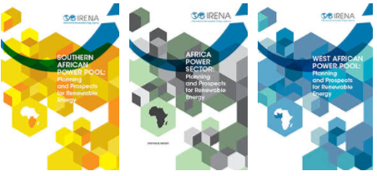

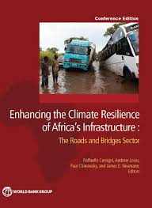

OSeMOSYS Applications
OSeMOSYS
IRENA African Power Pools: Planning and Prospects of Renewable Energy
IEA WEO 2014 – Africa Energy Outlook
WB – Enhancing the Climate Resilience of African Infrastructure
UNECE transboundary nexus assessments
(Sava and Drina)

Slide 5
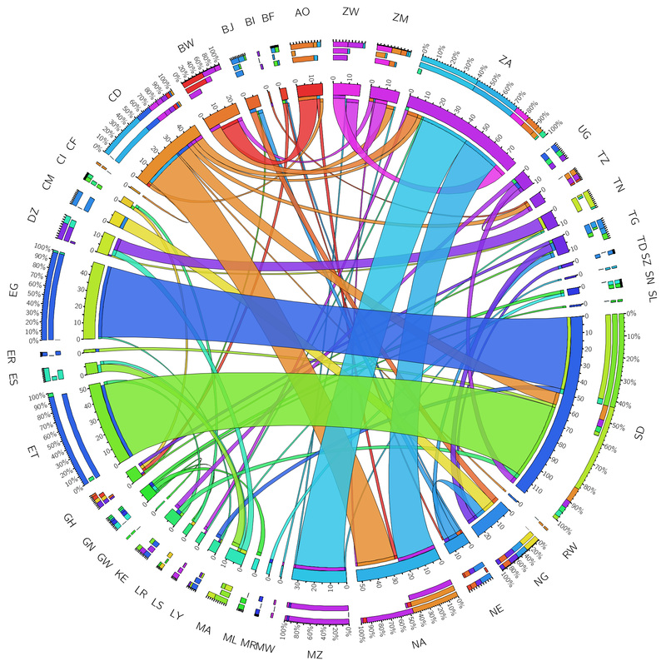
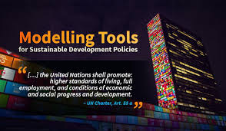
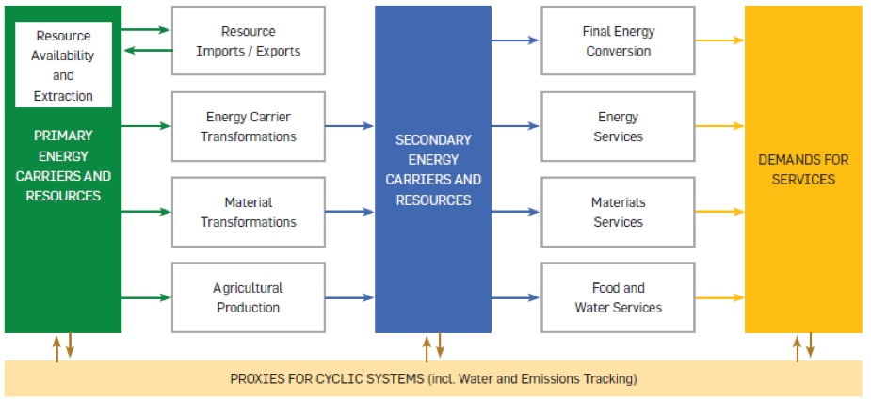
OSeMOSYS Applications
OSeMOSYS
TEMBA – The Energy Model Base for Africa
SAMBA – South America Model Base
CLEWS applications (GLUCOSE, Uganda, Nicaragua, Zimbabwe, Mauritius, Kenya, Bolivia, …)
Among UNDESA modelling tools for sustainable development policies.

